Slide 1

Snip Speak
By
Salman Yousaf (2030-0070)
Aazain Shamsi (2030-0089)
Jahan Alam (2030-0303)
Supervisor:
Sir Zeeshan Aslam

Slide 2
Outline
Introduction
Objective
Methodology
Flowchart
Proposed Design Architecture
FYP Progress

Slide 3
Introduction
In today's digital age, access to information is vital for personal and professional growth. However, not everyone has the same level of access. Our project seeks to bridge this gap by creating a system that can recognize text in images and make it accessible to a wider audience.

Slide 4
Objective
Our main objectives are to:
Develop a robust and accurate OCR system to extract text from images.
Implement a Text-to-Speech (TTS) module for converting recognized text into speech.
Seamlessly integrate OCR and TTS components to provide a smooth conversion process.
Create a user-friendly interface for interacting with the system.

Slide 5
Methodology
Image Preprocessing
Utilize noise reduction techniques like Gaussian blur and median filtering.
Apply binarization methods to enhance text visibility.
Text Recognition (OCR)
Implement deep learning models, possibly based on CNN architectures.
Train the OCR model on a diverse dataset of text images.

Slide 6
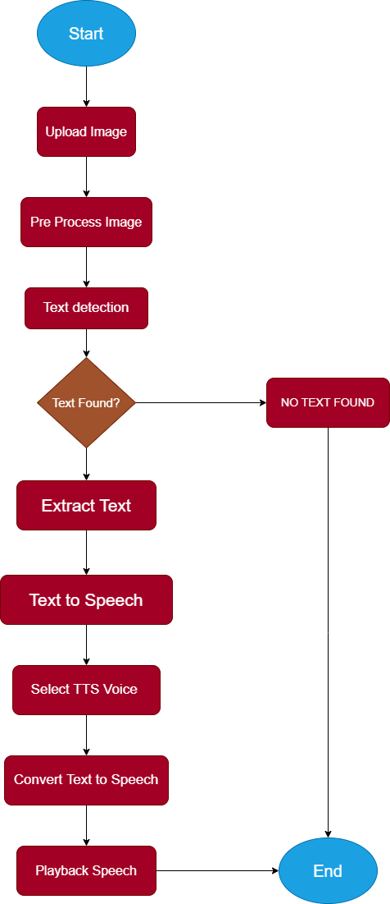
Flowchart
NO
YES

Slide 7
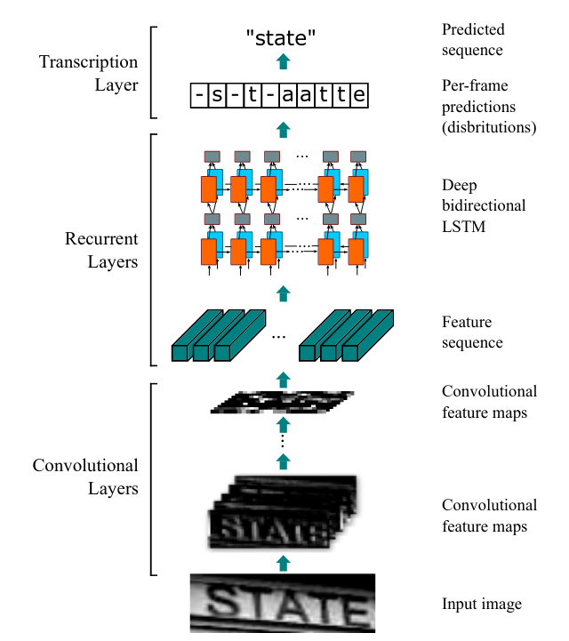
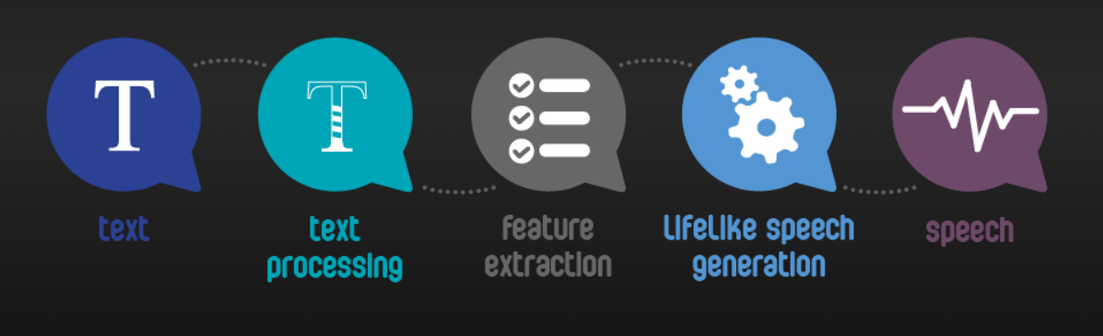
Design Architecture

Slide 8
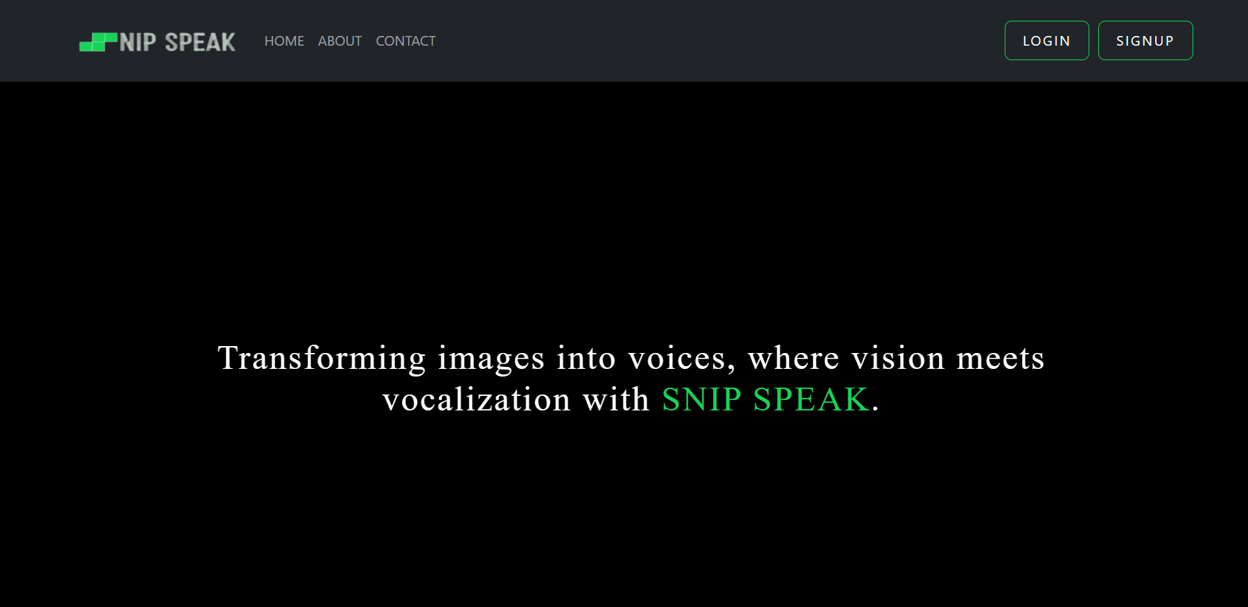
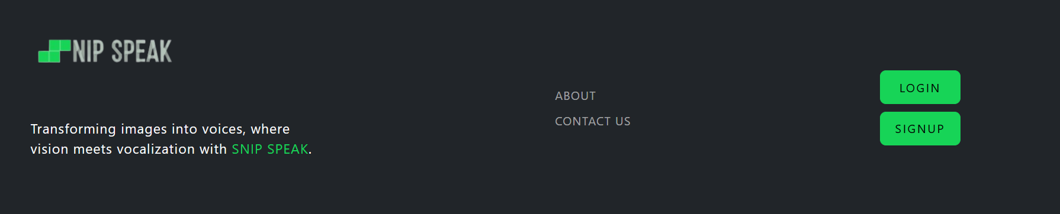
FYP PROGRESS
Front End (Website View)

Slide 9
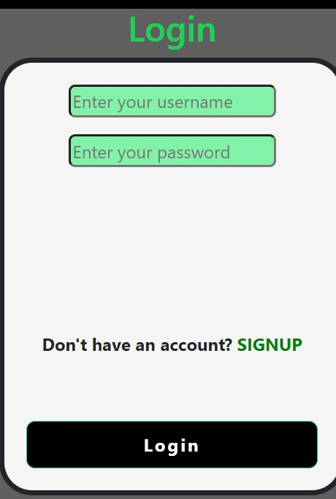
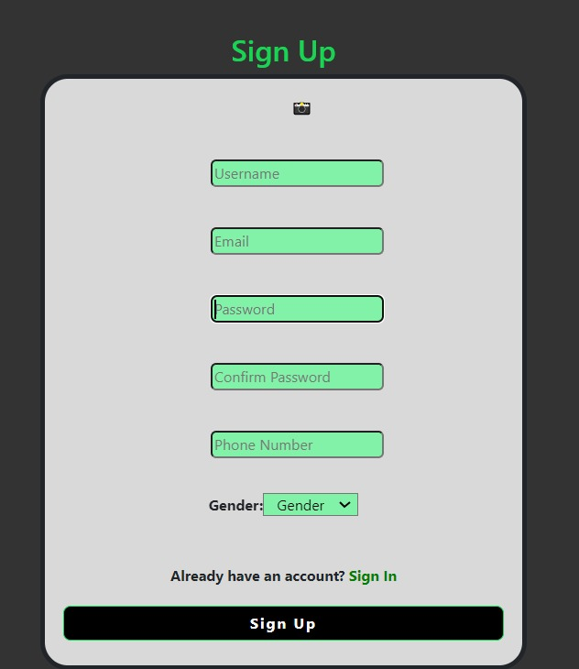
FYP PROGRESS
Front End (LOGIN/SIGNUP Page)

Slide 10
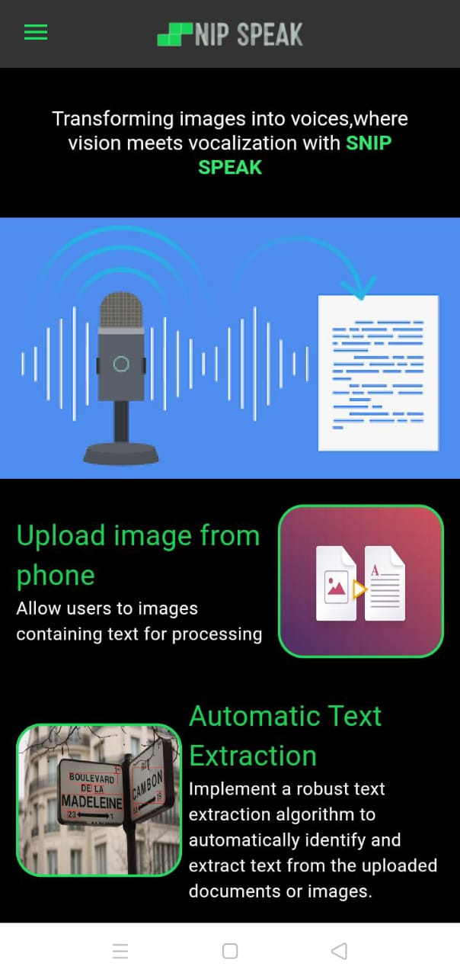
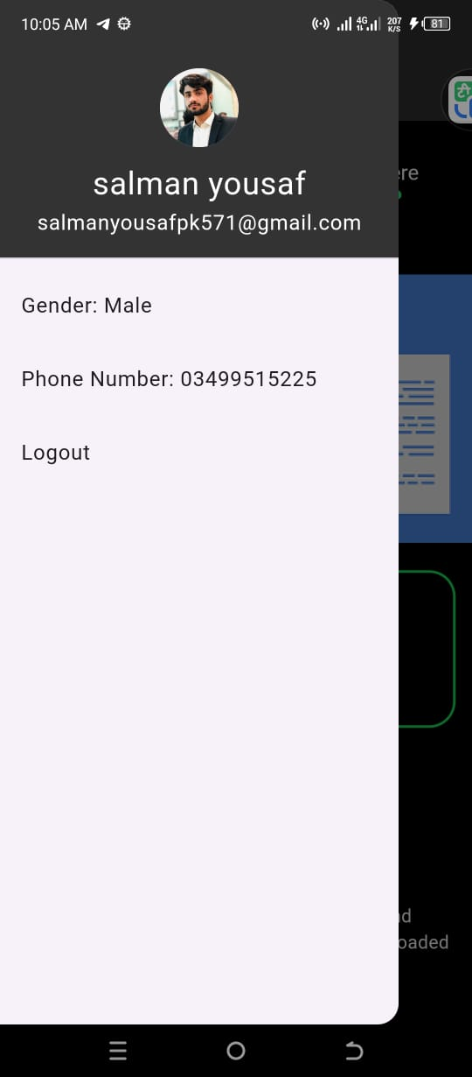
Mobile App View

Slide 11
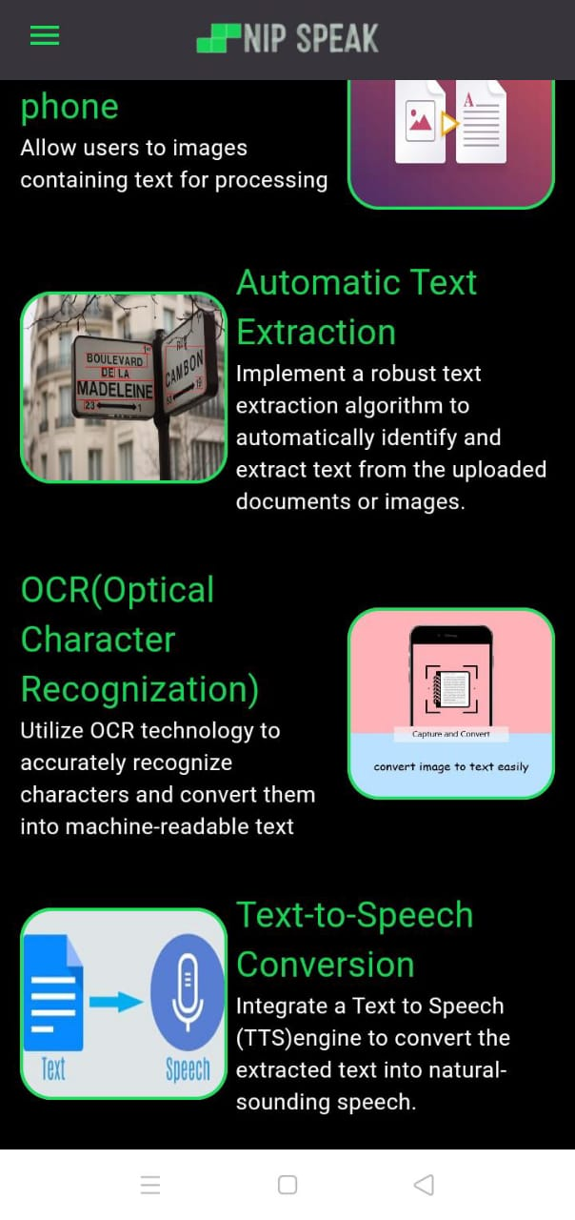
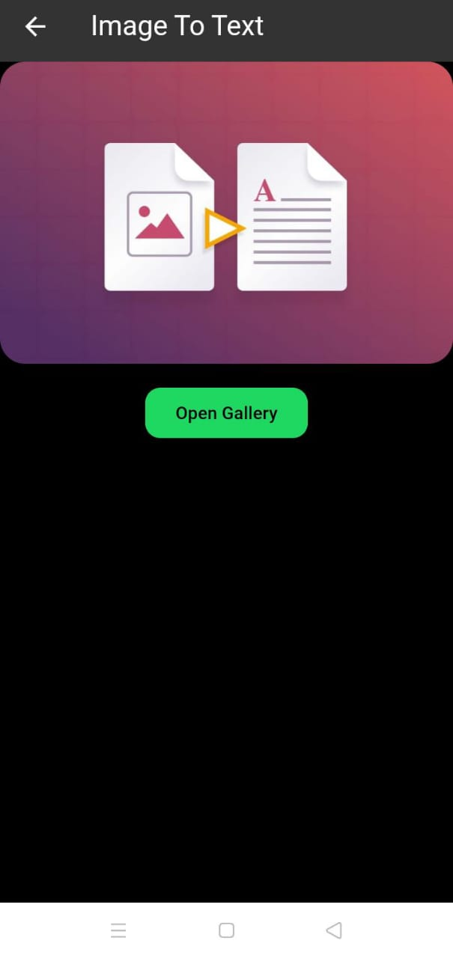
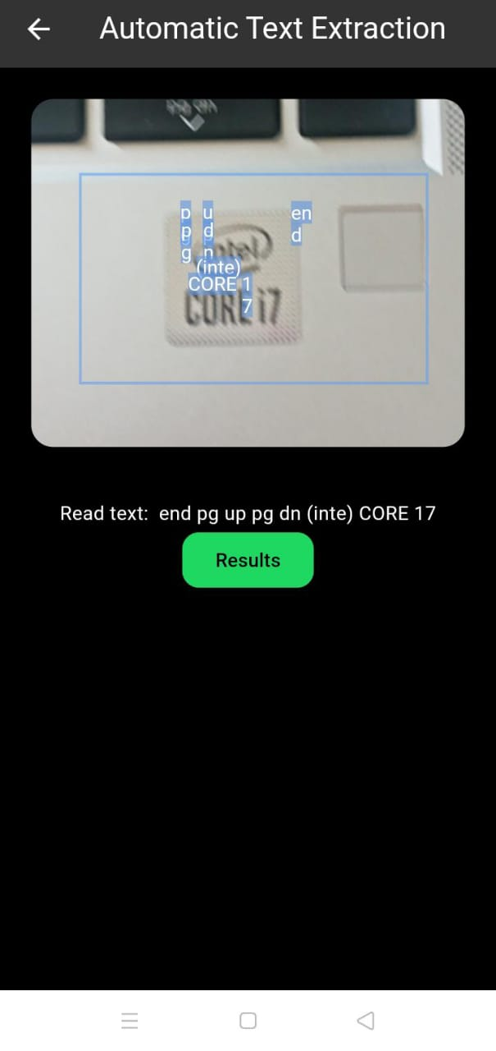
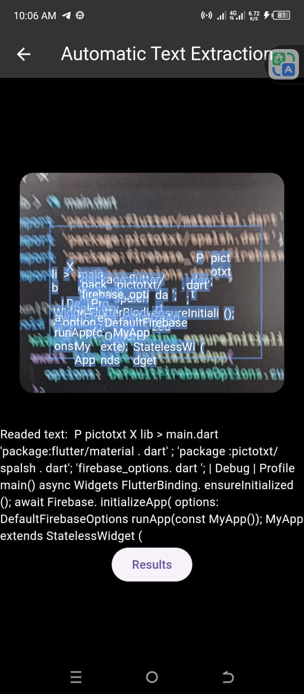

Slide 12
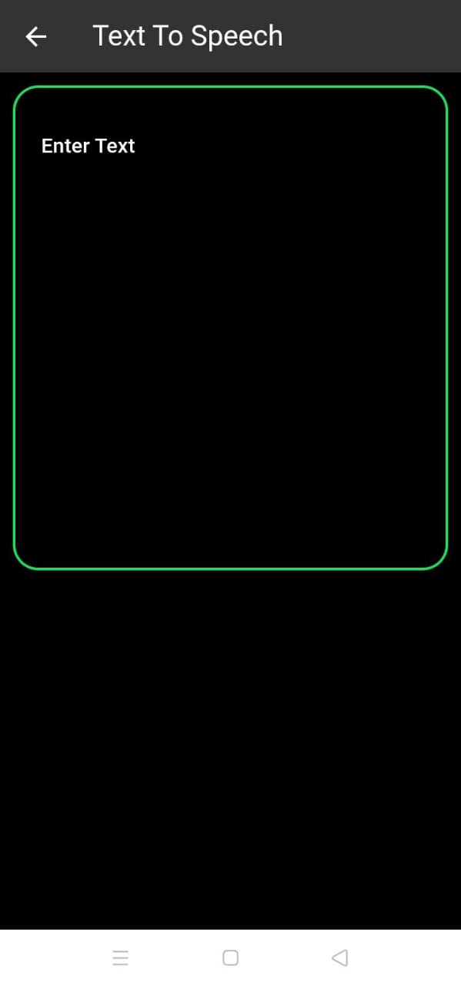

Slide 13
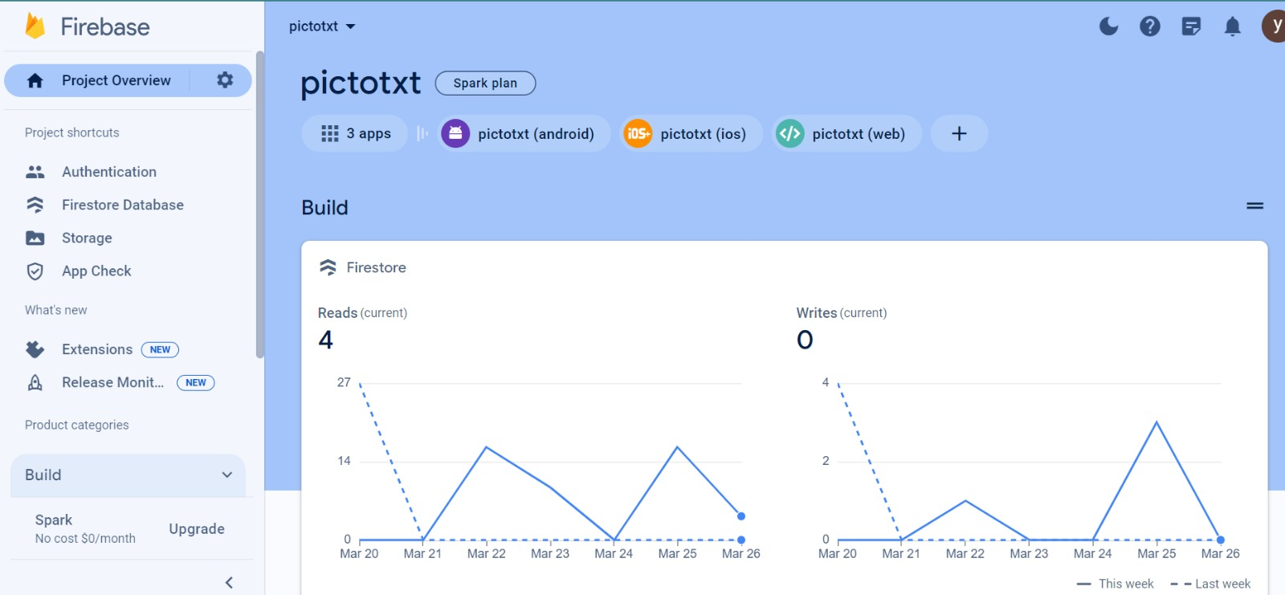
Database (Firebase)

Slide 14
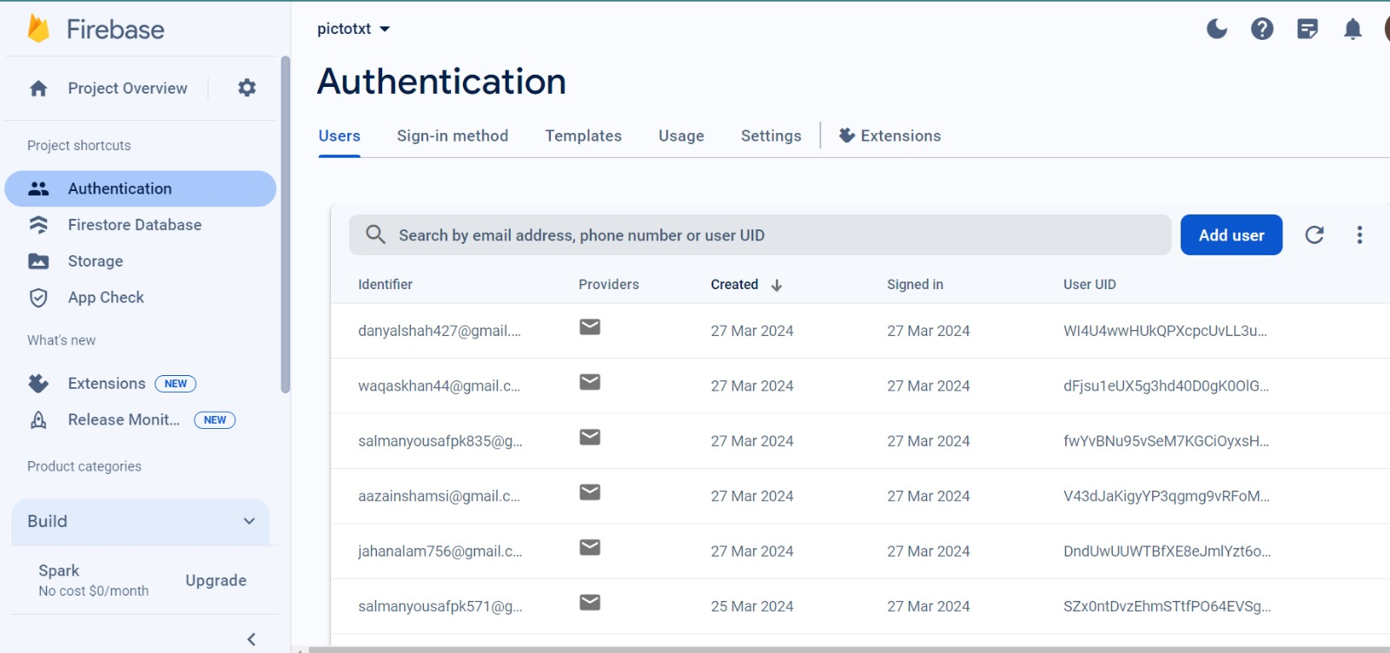

Slide 15
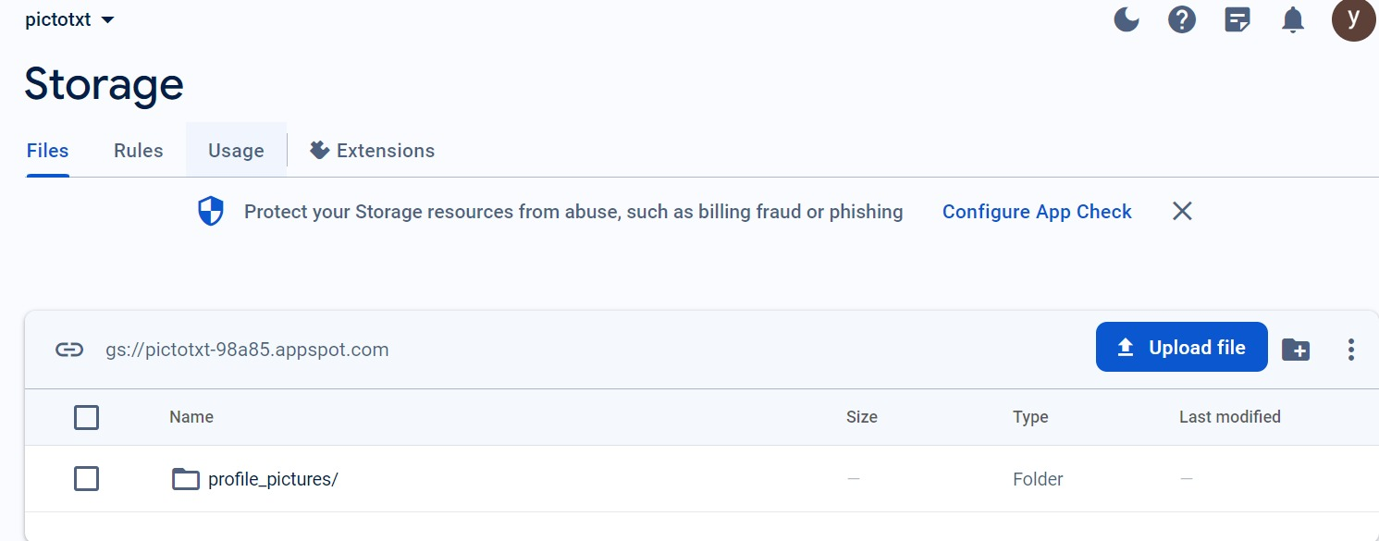

Slide 16
Thank You

